Slide 1


MFE5210 Project - Algo Trading System
Group1:
邵 凯 221040010
江一橹 221040069
卓金俊 221040076
刁兴宁 221040078
Notes:
个人成长经历-》

Slide 2


Algo Trading System
Database
Trading Strategy
Back Testing System
Evaluation
Notes:
个人成长经历-》

Slide 3
Algo-trading system
Notes:
个人成长经历-》

Slide 4
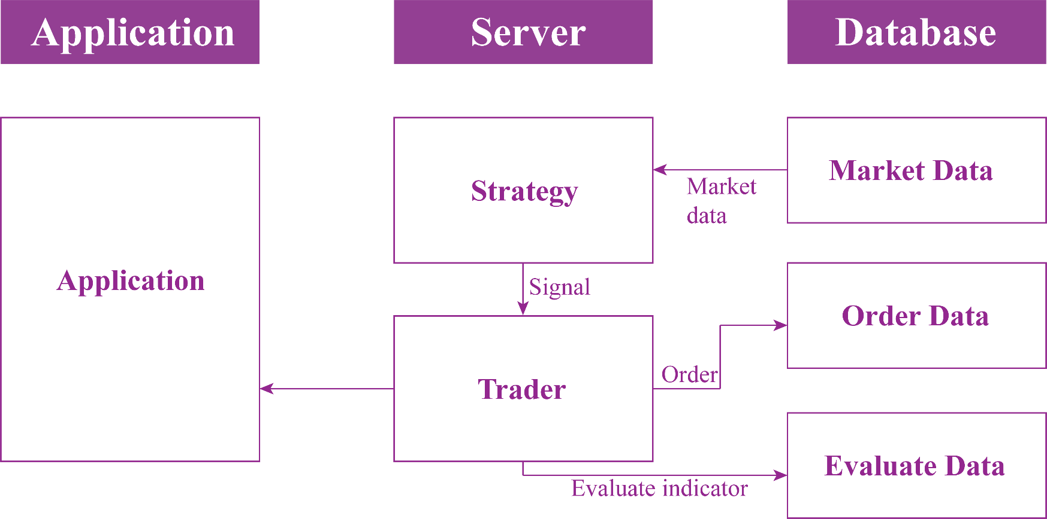
Algo-trading system structure
Notes:
个人成长经历-》

Slide 5
Database
Notes:
个人成长经历-》

Slide 6
Database
MySQL
● Use MySQL
● One DATABESE: mfe5210project
● Three TABLES:
1. market_data_backtest
2. market_data_trade
3. order_data
Notes:
个人成长经历-》

Slide 7
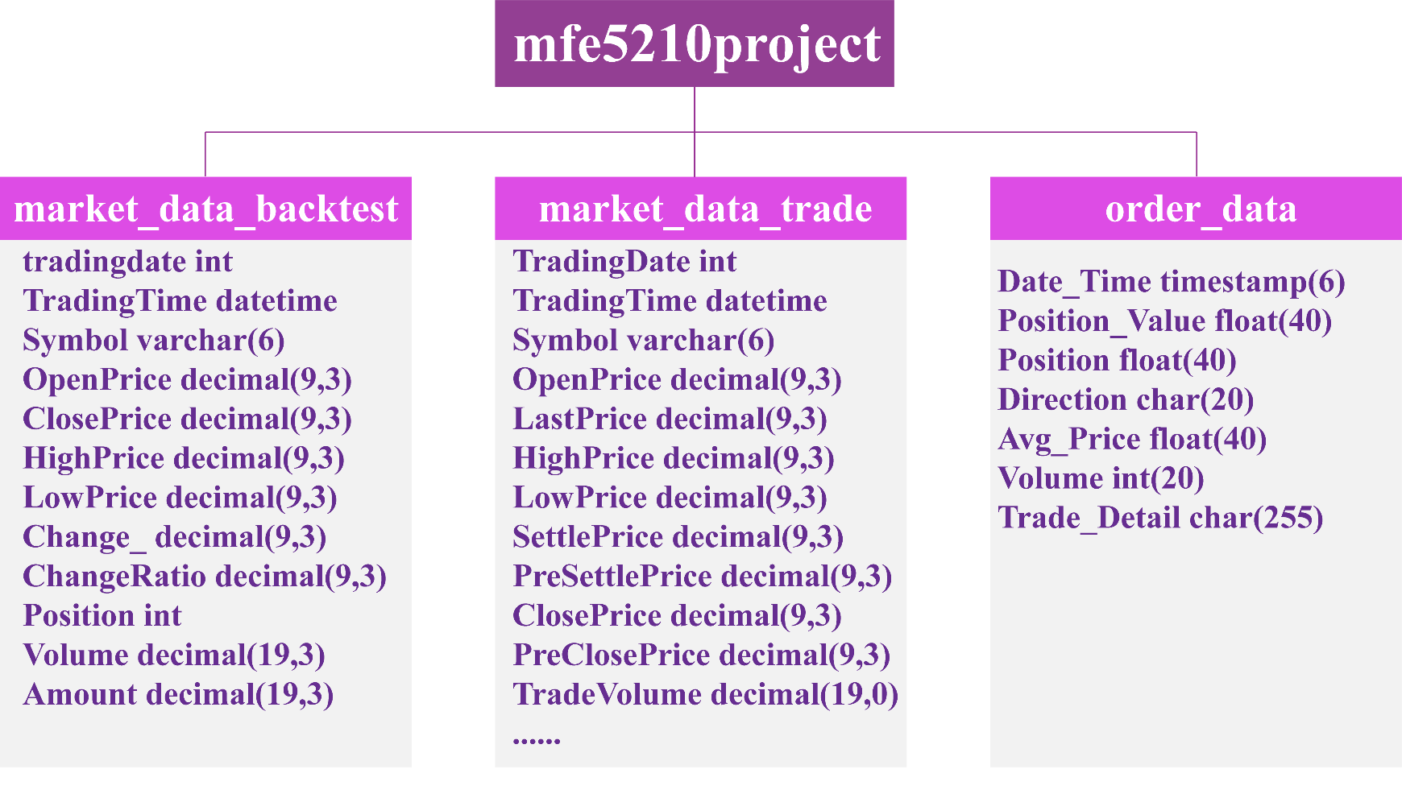
Database
MySQL
Notes:
个人成长经历-》

Slide 8
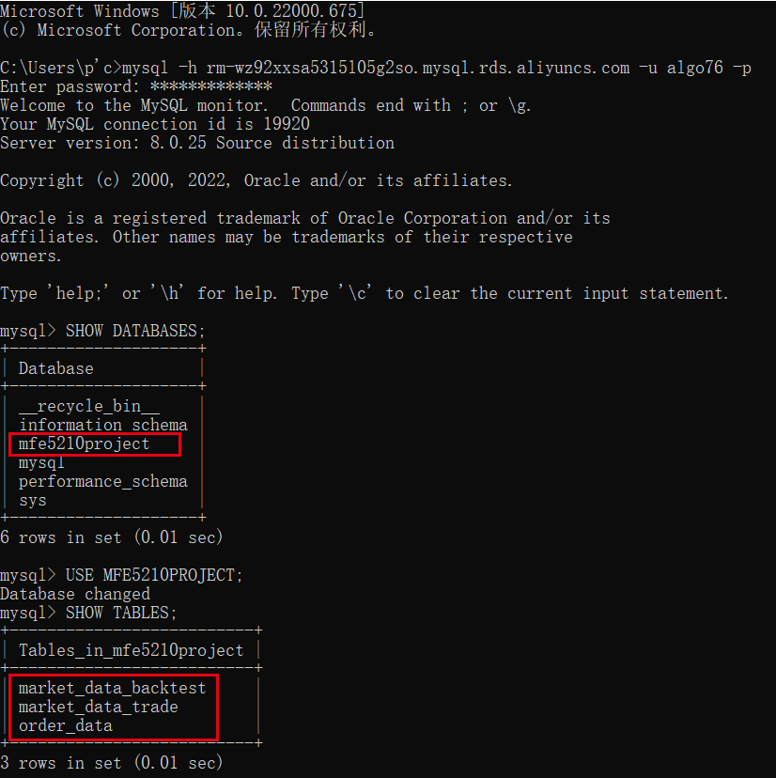
Database
MySQL
Notes:
个人成长经历-》

Slide 9
Sample Strategy
ResNet
Notes:
个人成长经历-》

Slide 10
Sample Strategy
Data Preprocessing
● Assets: CSI 300 stock index futures
● Back test period: January 1, 2022 to February 28, 2022
● Frequency: 1 min
● Labels: The returns after 30 minutes was calculated. The top 30% of samples returns were selected as the positive label (y = 1), the bottom 30% as the negative example (y = -1), and the remaining samples were labeled as 0
Notes:
个人成长经历-》

Slide 11
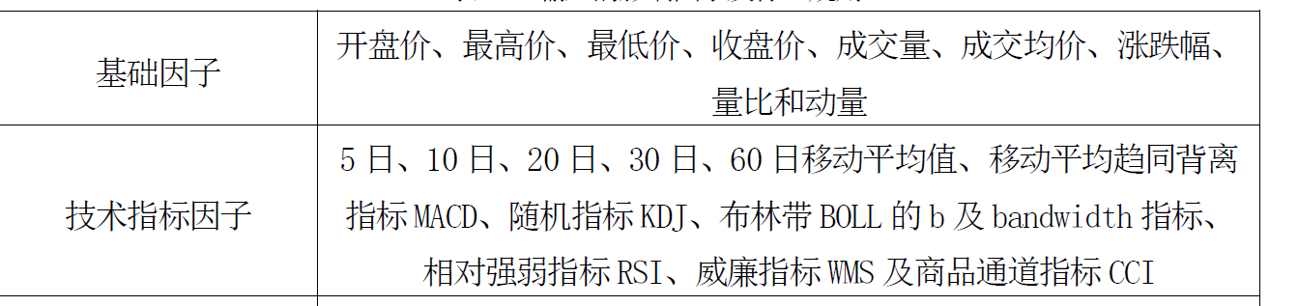
Sample Strategy
Data Preprocessing
● Features: The factor pool is shown in figure
● Winsorize
● Standardized
● Organize data into 2d
Notes:
个人成长经历-》

Slide 12
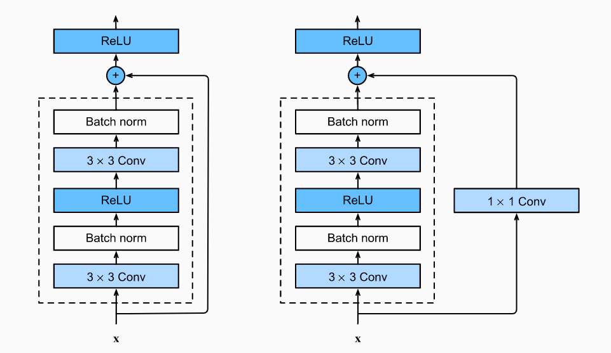
Sample Strategy
Module
●ResNet
●Residual block
●Sum y and x
Notes:
个人成长经历-》

Slide 13
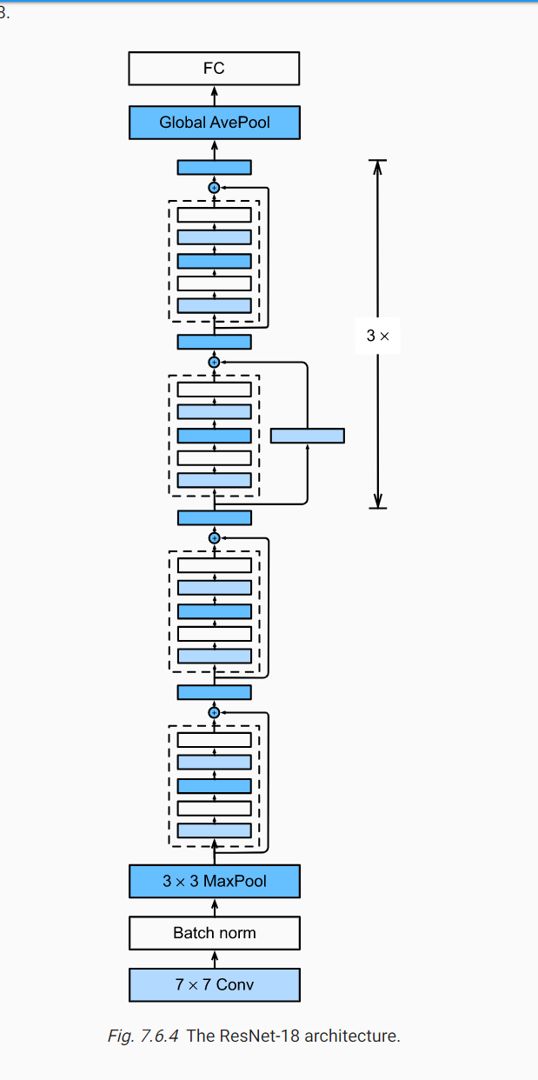
Sample Strategy
The whole Model
Notes:
个人成长经历-》

Slide 14
Sample Strategy
Generating Signal
● For label==1, we buy in,
● and automatically sell out after 30 mins
● For label==0 or -1 we do nothing
Notes:
个人成长经历-》

Slide 15
Sample Strategy
Results
● Training accuracy: 66% for all labels
● Test accuracy: 35% for all labels
● Training TPR: 82% for all labels
● Test TPR: 54% for all labels
Notes:
个人成长经历-》

Slide 16
Back Testing System
Notes:
个人成长经历-》

Slide 17
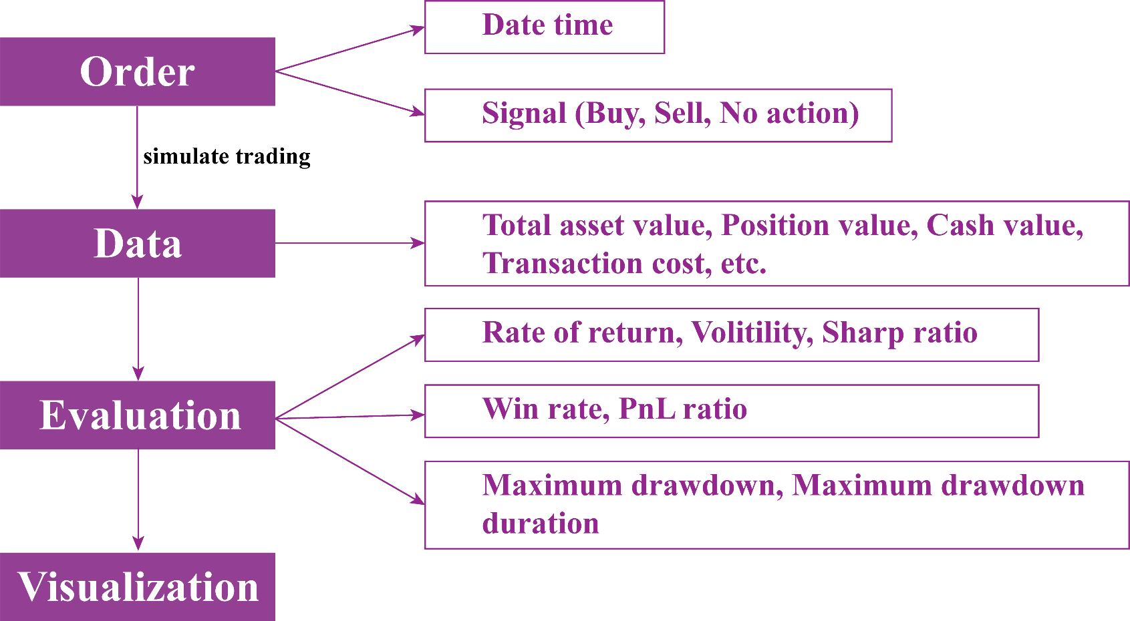
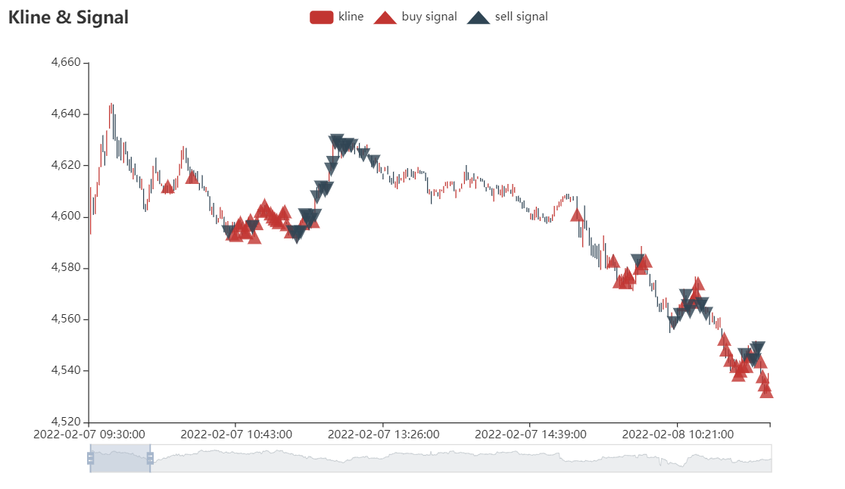
Back Testing System
Workflow
Notes:
个人成长经历-》

Slide 18
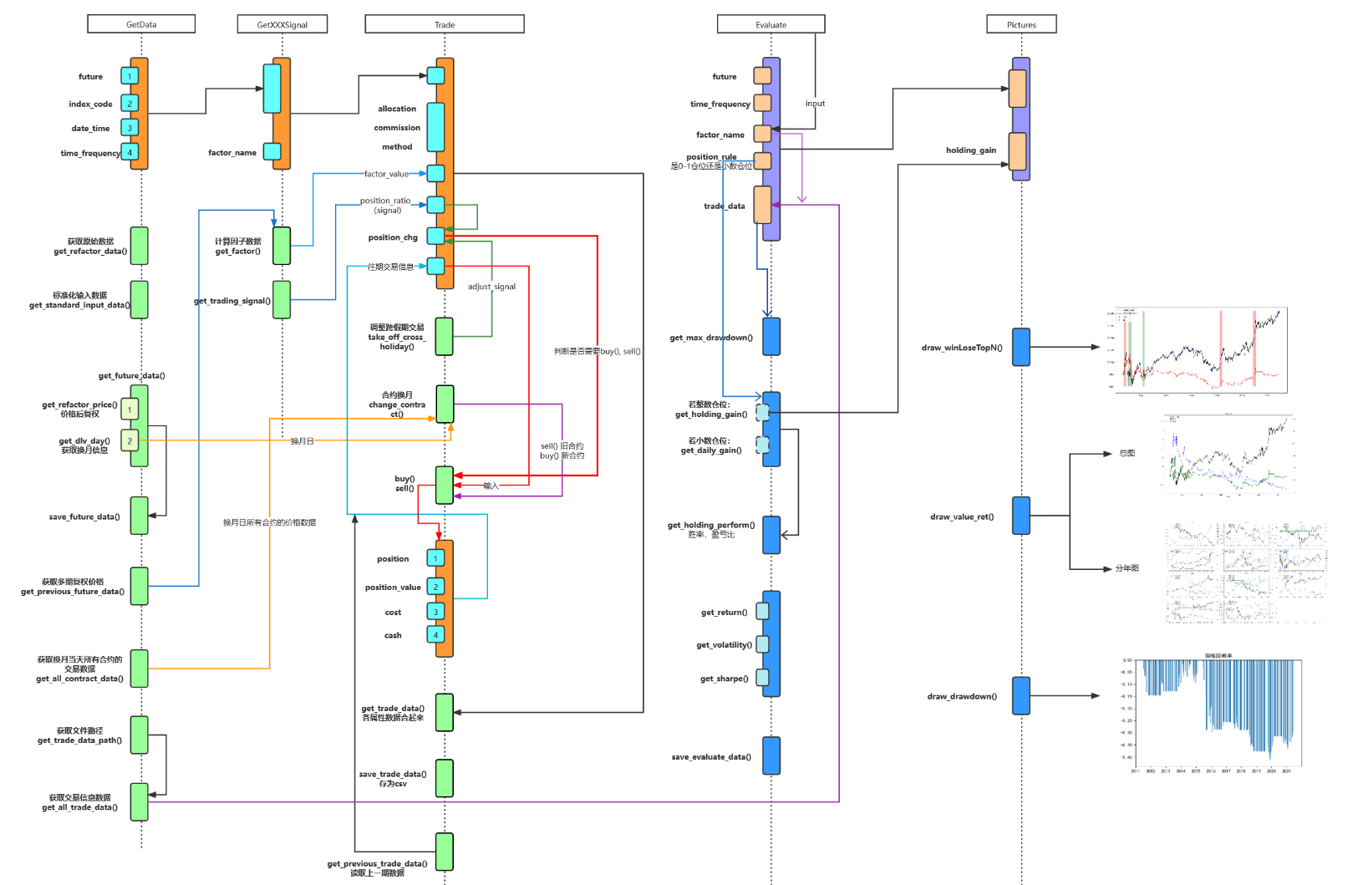
Back Testing System
Notes:
个人成长经历-》

Slide 19
Back Testing System
Signal
Trade
Evaluate
Pictures
. . .
Notes:
个人成长经历-》

Slide 20
Back Testing System
Signals
Notes:
个人成长经历-》

Slide 21
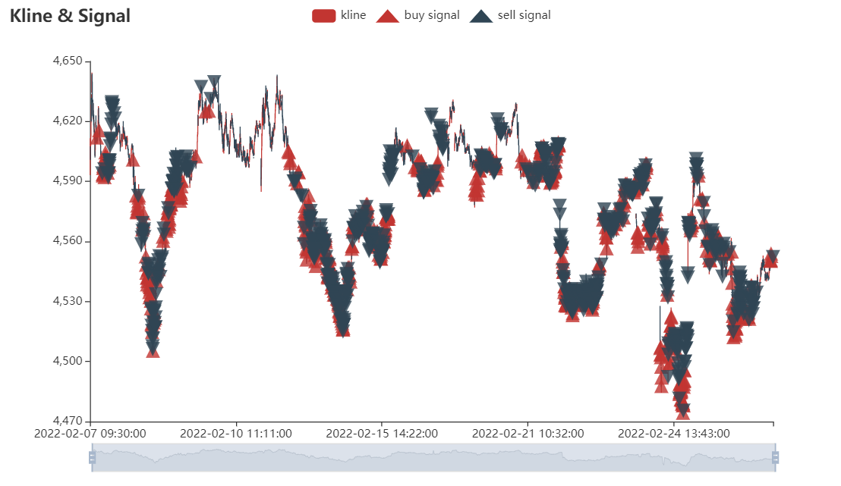
Back Testing System
Signals
Notes:
个人成长经历-》

Slide 22
Evaluation
Notes:
个人成长经历-》

Slide 23
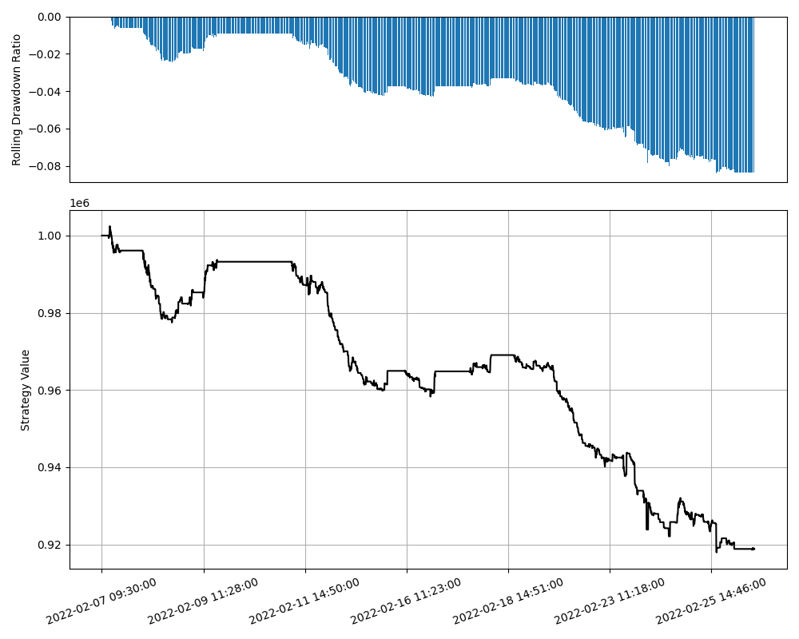
Evaluation
Strategy value
Notes:
个人成长经历-》

Slide 24
Evaluation
Strategy evaluation data
week | Maximum Drawdown | Maximum Drawdown Period | win_ratio | win_loss_ratio | Annualized Return | Annualized Volatility | Sharpe Ratio | Calmar Ratio
2022/2/13 | -0.024900235 | from 2022/02/07 to 2022/02/08 | 0.81147541 | -0.32479598 | -0.00259 | 0.076811 | -0.0337 | -0.10397
2022/2/20 | -0.031653356 | from 2022/02/14 to 2022/02/17 | 0.769784173 | -0.48975191 | -0.00373 | 0.086472 | -0.04309 | -0.11772
2022/2/27 | -0.048450584 | from 2022/02/21 to 2022/02/24 | 0.794202899 | -0.35382719 | -0.00908 | 0.132814 | -0.06837 | -0.18743
2022/3/6 | -0.008272185 | from 2022/02/28 to 2022/02/28 | 0.895833333 | -0.14148487 | -0.00739 | 0.136692 | -0.05408 | -0.89356
Notes:
个人成长经历-》

Slide 25
Thank you!
Notes:
个人成长经历-》

